Slide 1
Online Book Store
Group No: 08
Presented By:
Akshay Choure (1009)(PRN 210541281006)
Pranali Pawar (1144) (PRN 210541281134)

Slide 2
Contents
Introduction
Objective
Activity Diagram
Use Case Diagram
ER Diagram
Implementation
Conclusion

Slide 3
Introduction
Online Book store is an online web application where the customer can purchase books online, through a web browser.
The web application will provide the basic functionalities to the users, i.e. selecting the book, putting the same in the cart and purchasing it in the end.
The Administrator is responsible and authorized to fill up the data into the database as well as Update the data accordingly.

Slide 4
Objective
Web based system where people can purchase books online from their home
Saves time and space
Easy to maintain the record of books and customer for admin

Slide 5
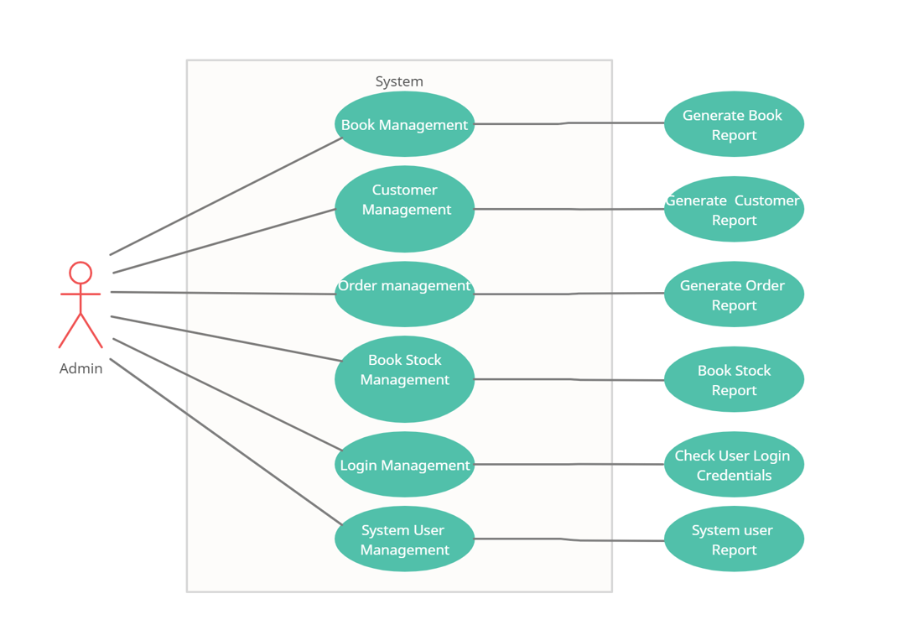
Activity Diagram Admin

Slide 6
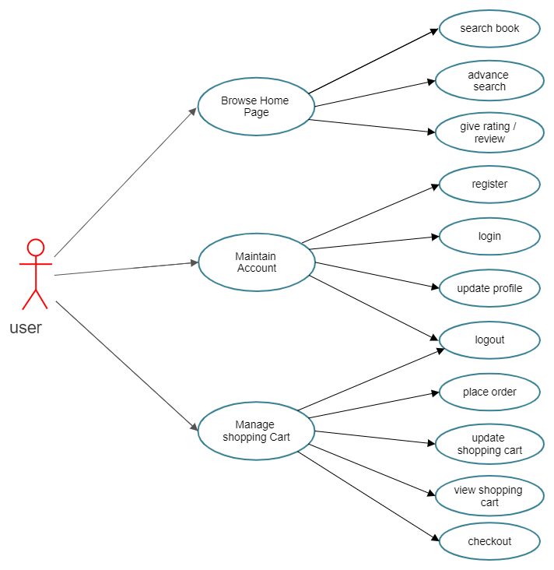
Activity Diagram user

Slide 7
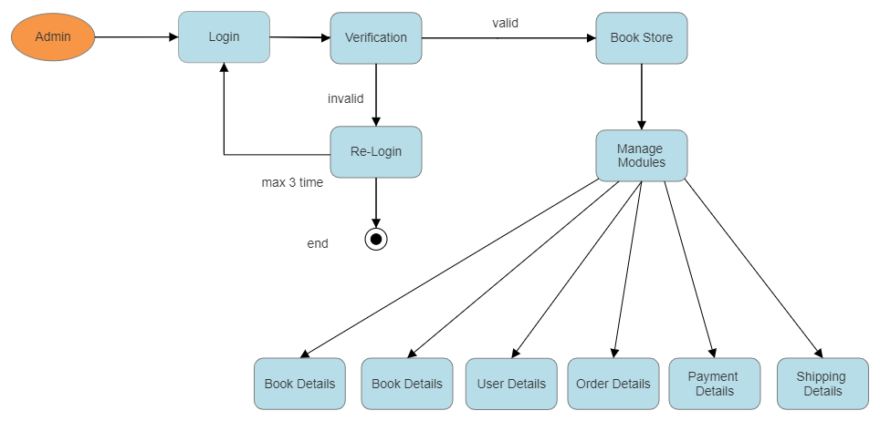
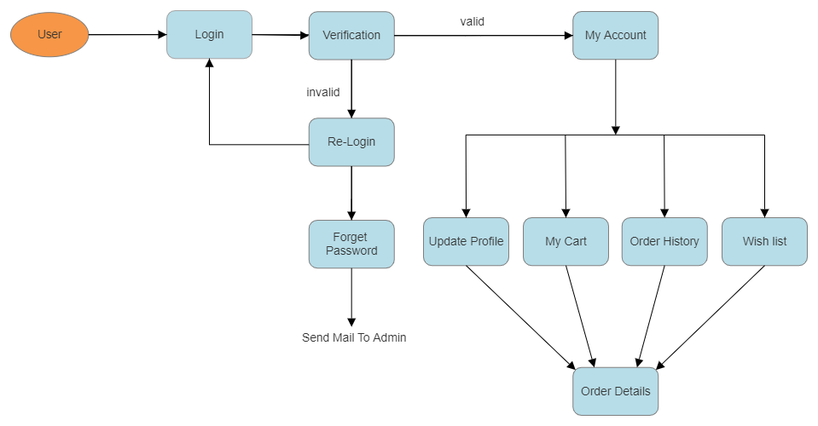
Use Case Diagram

Slide 8
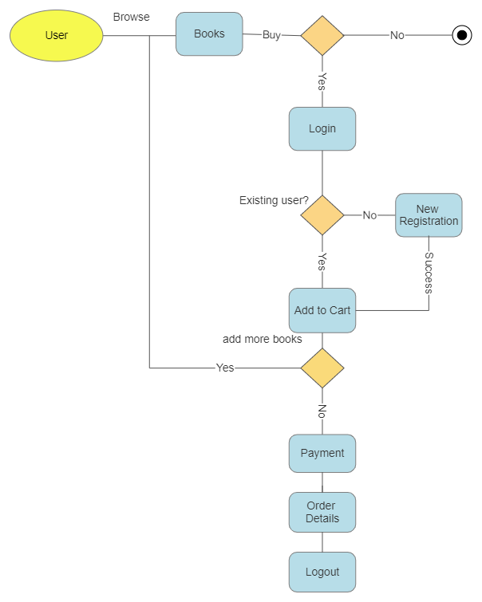
Data Flow Diagram

Slide 9
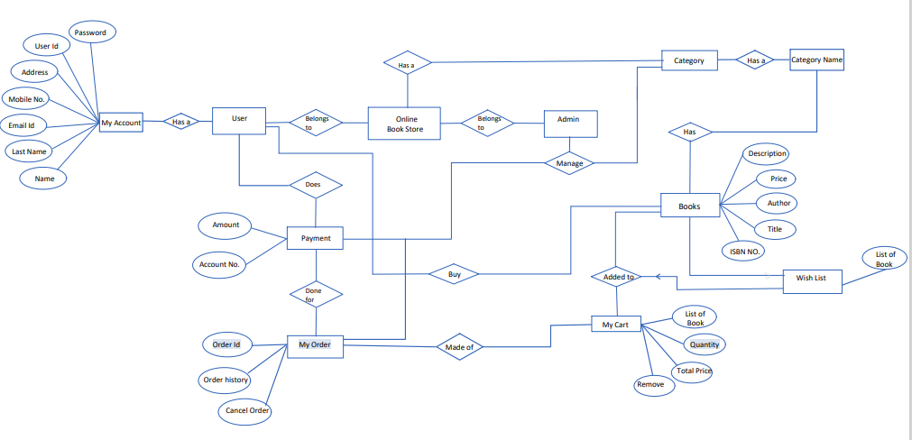
ER Diagram

Slide 10
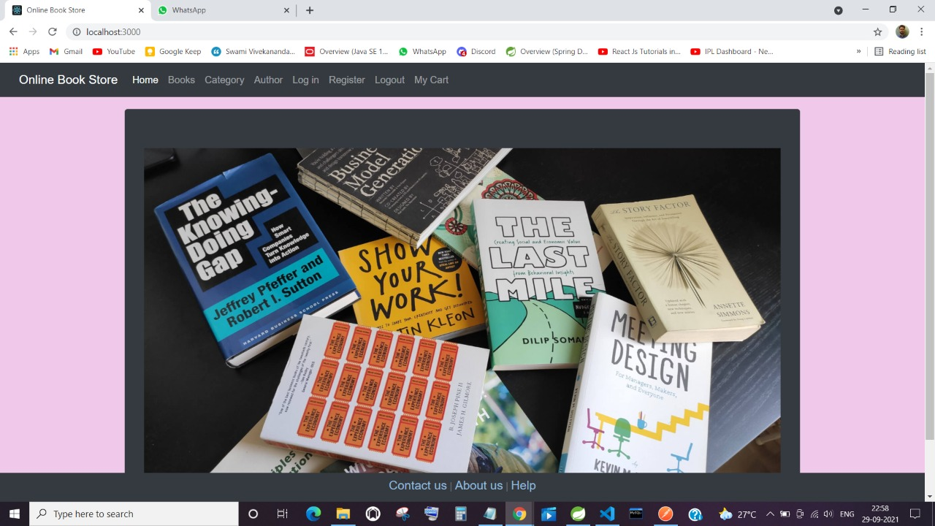
Implementation Home Page

Slide 11
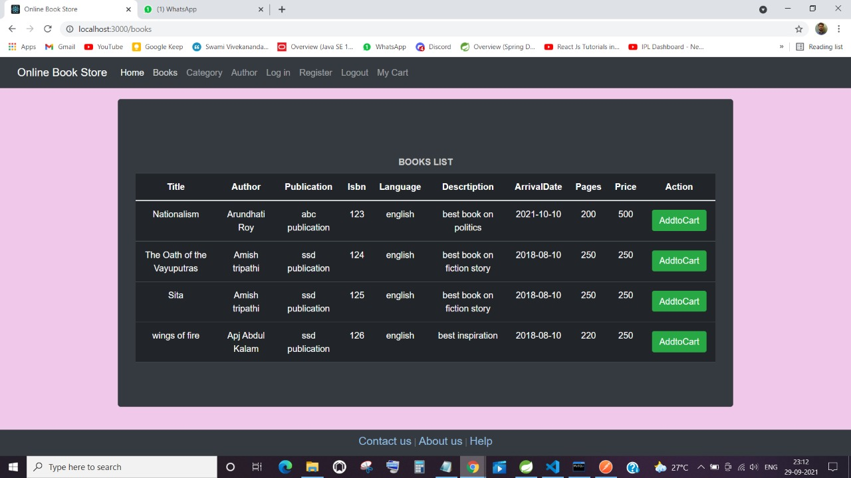
Books List

Slide 12
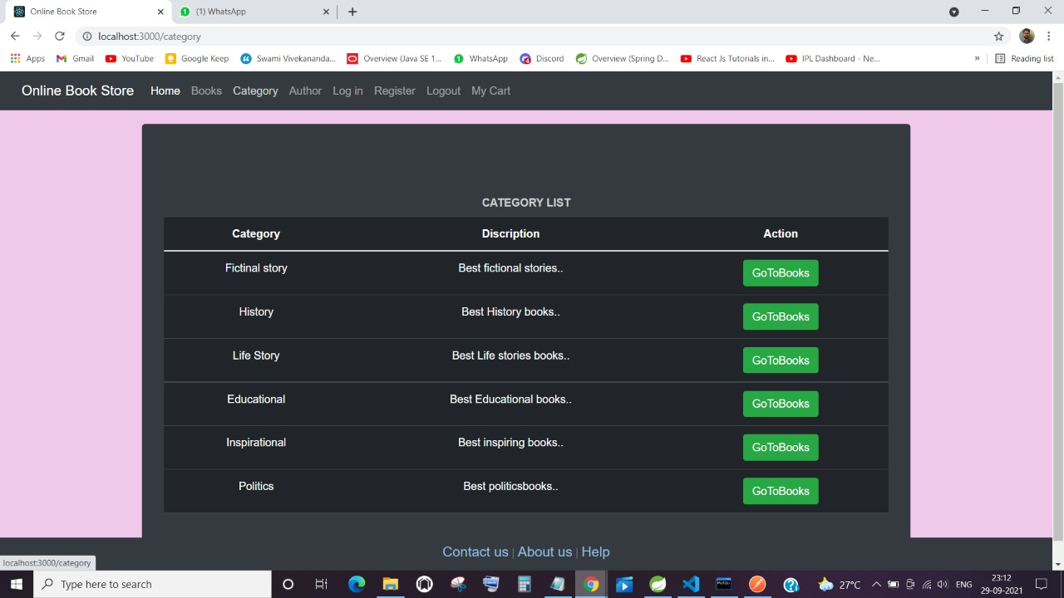
category

Slide 13
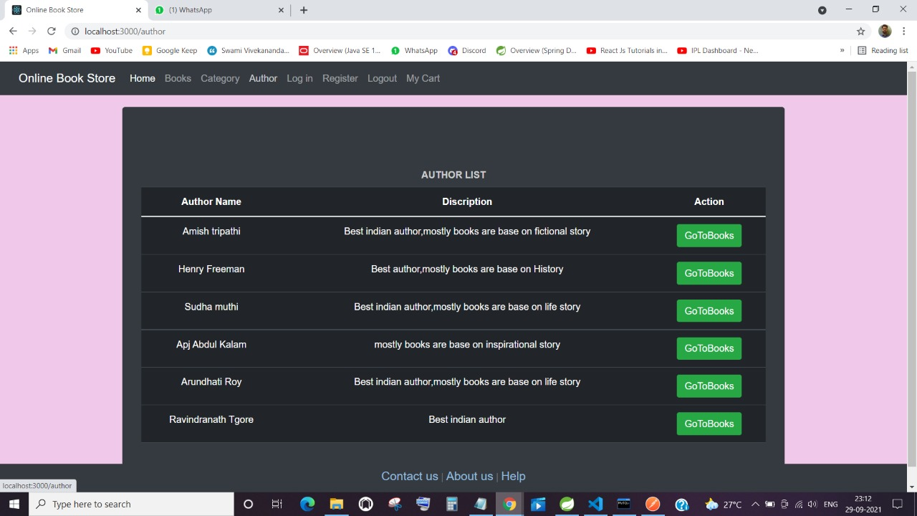
Author

Slide 14
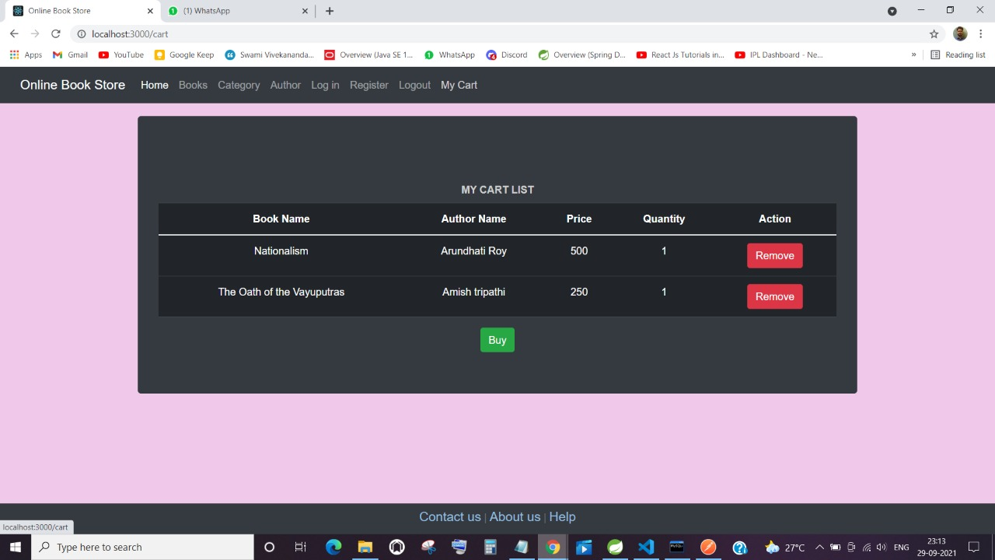
My cart

Slide 15
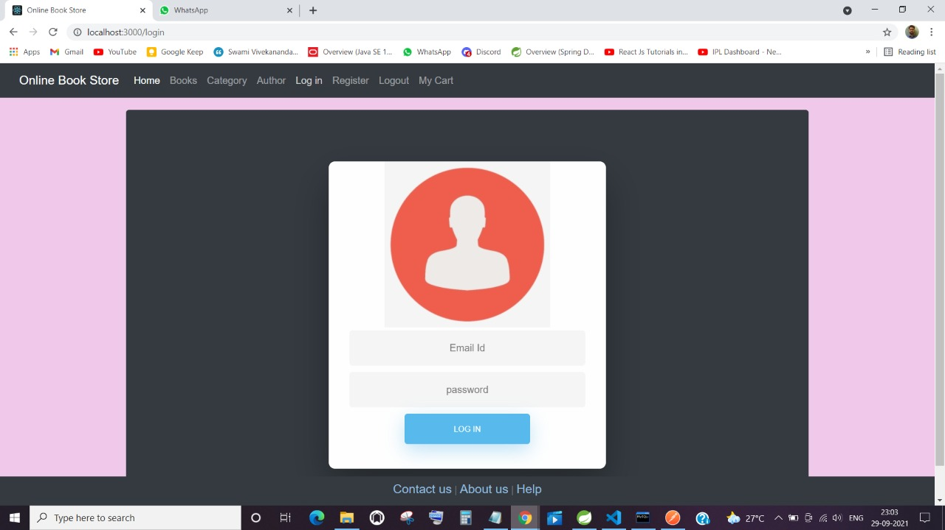
Login

Slide 16
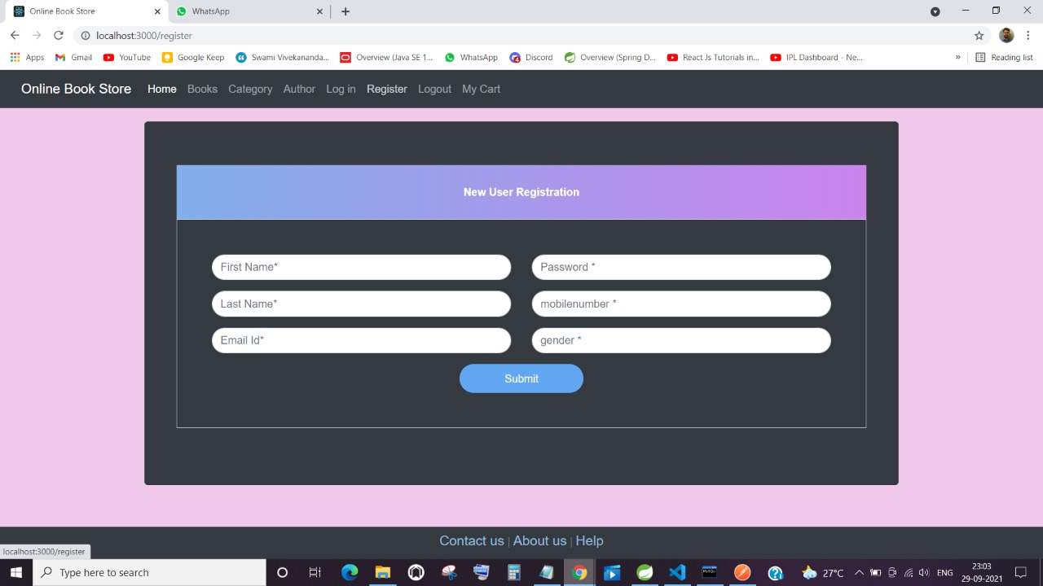
Register

Slide 17
Conclusion
Online bookstore has many advantages compared to its counterparts such as physical book store, the online bookstore allows it's user to shop at one place where in physical store the books are scattered at the different places which consumes a lot of time and online bookstore helps in saving that time and it also avoids the problem of unavailability of books at physical store as numerous vendors from different places sell their books at one place.

Slide 18
Thank You

